Slide 1
Thrombotic Microangiopathy & Associated Renal Disorders
Tom Oates PhD FRCP
Royal London Hospital
North London Renal Training Day
11 Apr 24

Slide 2
Declaration
Alexion paid for my hotel and registration at the UK Renal Association 2016
I attended the ‘Clinical Excellence in TMA’ conference in Essen, Germany in June 2017. Alexion paid for all flights, registration, transfers and accommodation for this
Alexion have provided compassionate use Eculizumab for patients I have looked after

Slide 3
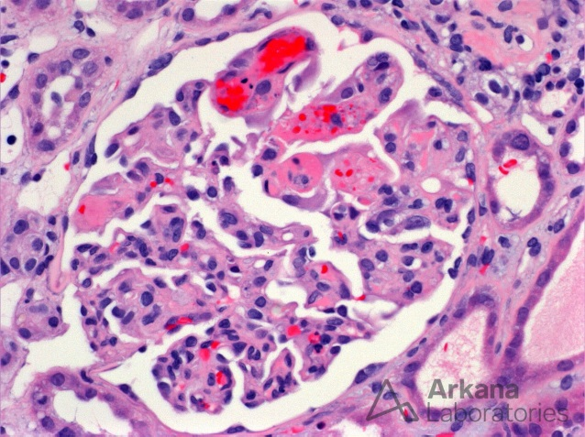
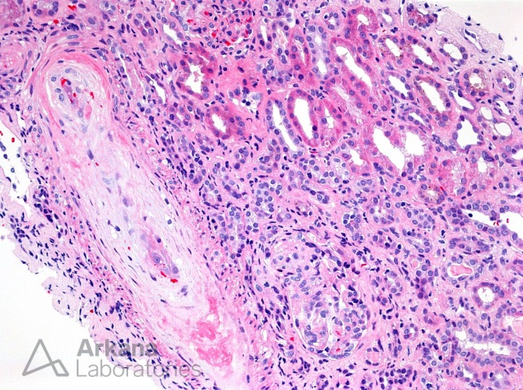
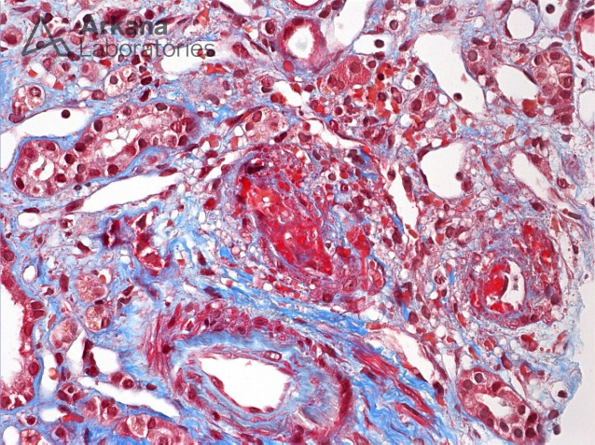
Some Definitions
Thrombotic Microangiopathy (TMA)
Specific pathologic lesion where abnormalities in arteriole & capillary walls lead to microvascular thrombosis
Commonly inferred from MAHA and thrombocytopenia co-occurring in the appropriate clinical setting

Slide 4
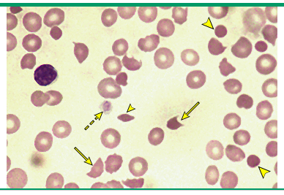
Some Definitions
Microangiopathic Haemolytic Anaemia (MAHA)
Non-immune haemolysis
Intravascular red blood cell fragmentation producing fragments on the blood film
Often due to abnormalities in arteriole & capillary walls but intravascular devices also implicated
Not all MAHA is caused by TMA but almost all TMAs cause MAHA & thrombocytopenia
Coombs Test/DAT | Negative
LDH | Increased
Bilirubin | Increased
Haptoglobins | Low

Slide 5
Thrombocytopenia
MAHA
±
Organ dysfunction
Primary TMA Syndromes
Systemic Diseases associated with low Plt & MAHA
TTP
STEC-HUS
aHUS
Drug induced TMA
Cancer induced TMA
Metabolism TMA
Coagulation TMA
Complications of pregnancy
Hypertension
Infections
Malignancy
Rheumatic diseases
HSCT/other organ Tx

Slide 6
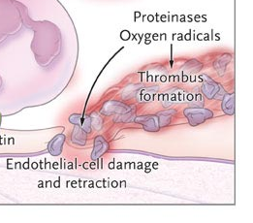
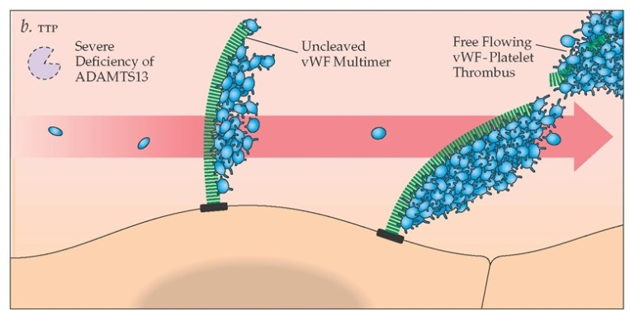
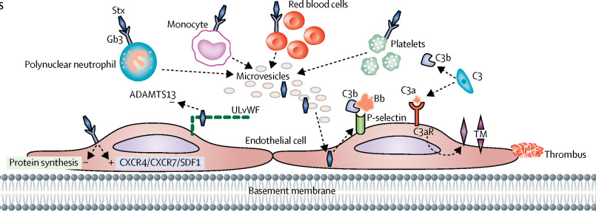
Aberrant Complement
Activation
↓
Membrane Attack Complex
Ultra Large-vWF
CFH & CFI
CFB & C3
ADAMTS13 Deficiency
STEC HUS
aHUS
TTP

Slide 7
Thrombotic Microangiopathy: Working your way through the differential
MAHA
Anaemia
Fragments
Increased bilirubin & LDH
Platelet Count? 30x10⁹/L
Creatinine? 180umol/L
ADAMTS13
Platelet Count <30x10⁹/L
MCV <90fL
Creatinine <180umol/L
INR <1.5
Haemolysis
Retics >2.5%
Bili >35umol/L
Undetectable Hapto
No active cancer
No Hx BM/organ Tx
10%
Score≥5
Treat as TTP
PEx
AJCP (2016), 145, 158

Slide 8
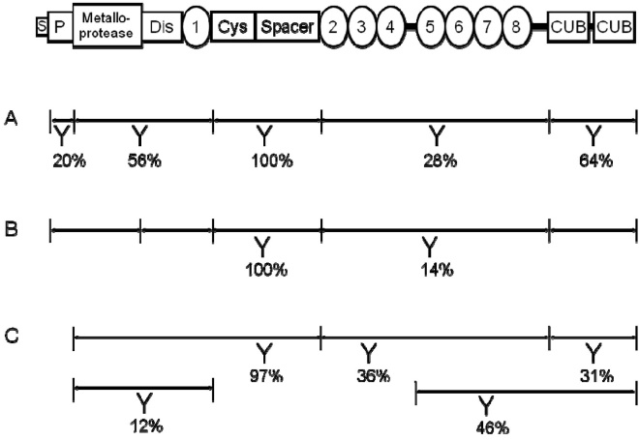
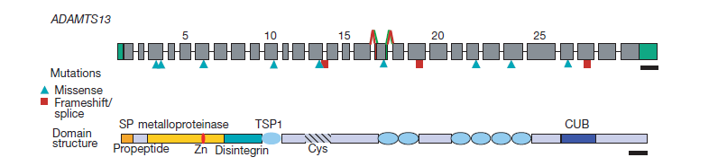
How does ADAMTS13 activity get below 10%?
Acquired
Congenital
INHIBITION
MUTATION
Antibodies to ADAMTS13 found in >90% of TTP
Primary target is the spacer domain
ADAMTS13 mutations are rare (>150pts worldwide) BUT may present at 20-40yo or even >60yo
Nature (2001), 413, 488

Slide 9
Thrombotic Microangiopathy: Working your way through the differential
Assess Systemic Disease
APLS
HIV
Hypertension
Plasma Cell Dysgracia
Scleroderma
SLE
G6PD
Pneumococcus
Pregnancy
Viral
APL antibody
HIV test
BP, ECG, Echo
sPEP, uPEP, FLC
ANA, anti-centromere, scl-70
dsDNA
G6PD activity
Urinary antigen
Pregnancy test
Influenza swab, CMV, EBV PCR
Treat Systemic Disease
The end?

Slide 10
Pregnancy & Complicated AKI: Everyone’s Nightmare
 | HUS | HELLP | Lupus | AFLP | Cortical Necrosis
Creatinine | ↑ | ↑/N | ↑/N | ↑/N | ↑
Platelets | ↓ | ↑ | ↓/N | ↓/N | N
Transaminases | N | ↑↑ | N | ↑ | N
LDH | ↑ | ↑ | N | ↑ | N
PT/PTT | N | ↑/N | N | ↑ | N
Fragments | Yes | Yes | No | No | No
BP | ↑ | ↑ | ↑/N | ↓/N | ↓/↑/N
Progression | Frequent | Rare | Variable | No | Frequent
From Nephrology Secrets (3rd Ed), Mosby

Slide 11
Thrombocytopenia
MAHA
±
Organ dysfunction
Primary TMA Syndromes
Systemic Diseases associated with low Plt & MAHA
TTP
STEC-HUS
aHUS
Drug induced TMA
Cancer induced TMA
Metabolism TMA
Coagulation TMA
Complications of pregnancy
Hypertension
Infections
Malignancy
Rheumatic diseases
HSCT/other organ Tx

Slide 12
Thrombotic Microangiopathy: Drug induced
Immune Mediated
Quinine
Gemcitabine
Oxaliplatin
Quetiapine
Toxicity Mediated
Gemcitabine
Mitomycin
FK/CsA
VEGFi (Sirolimus, Bevacizumab)
Cocaine
Oxymorphone
Acute Kidney Injury
Uptodate.com

Slide 13
Thrombocytopenia
MAHA
±
Organ dysfunction
Primary TMA Syndromes
Systemic Diseases associated with low Plt & MAHA
TTP
STEC-HUS
aHUS
Drug induced TMA
Cancer induced TMA
Metabolism TMA
Coagulation TMA
Complications of pregnancy
Hypertension
Infections
Malignancy
Rheumatic diseases
HSCT/other organ Tx

Slide 14
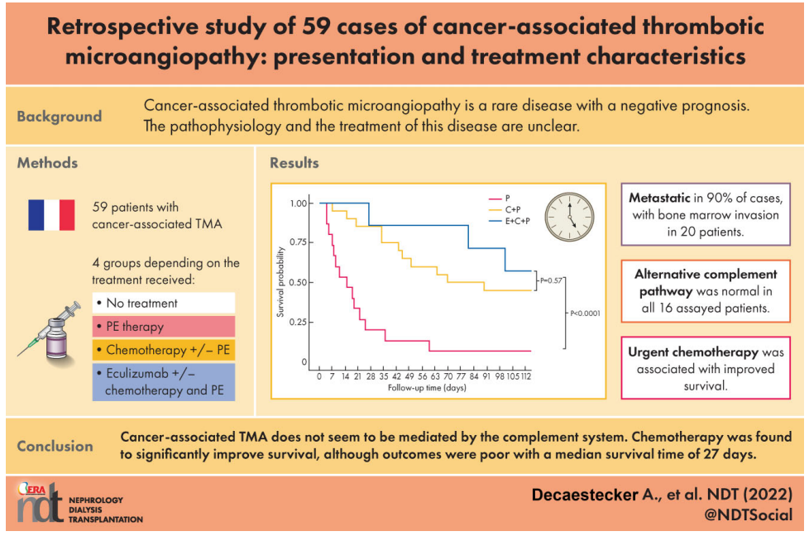
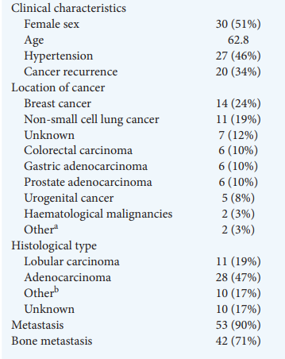

Slide 15
Thrombocytopenia
MAHA
±
Organ dysfunction
Primary TMA Syndromes
Systemic Diseases associated with low Plt & MAHA
TTP
STEC-HUS
aHUS
Drug induced TMA
Cancer induced TMA
Metabolism TMA
Coagulation TMA
Complications of pregnancy
Hypertension
Infections
Malignancy
Rheumatic diseases
HSCT/other organ Tx

Slide 16
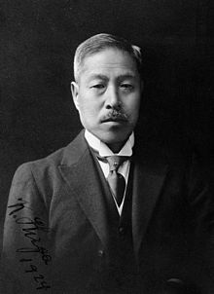
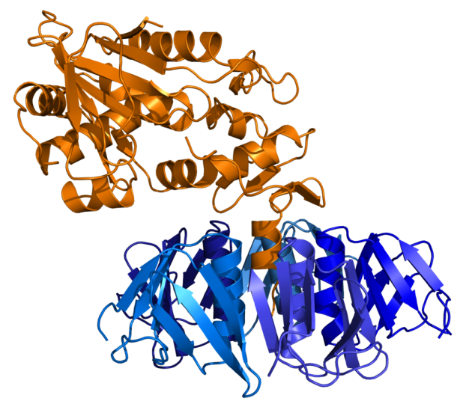
Thrombotic Microangiopathy: HUS – STEC or no STEC
Enterohaemorrhagic E. coli
>70% D+HUS in HICs
E. coli O157:H7
Disease of children
Shigella dysenteriae
LMIC
Mortality 15-40%
Uptodate.com

Slide 17
Thrombotic Microangiopathy: STEC-HUS – diagnosis
Evidence of STEC infection
Stool shiga toxin
Stool cultures
PCR for toxin virulence genes in stool
All performed at Colindale GI infections Reference Unit
All should be mandatory
Clinical…
~5% of STEC-HUS has no diarrhoea
30%+ of aHUS has diarrhoea
Bacterial shedding in stool happens early and for only a short time
Uptodate.com

Slide 18
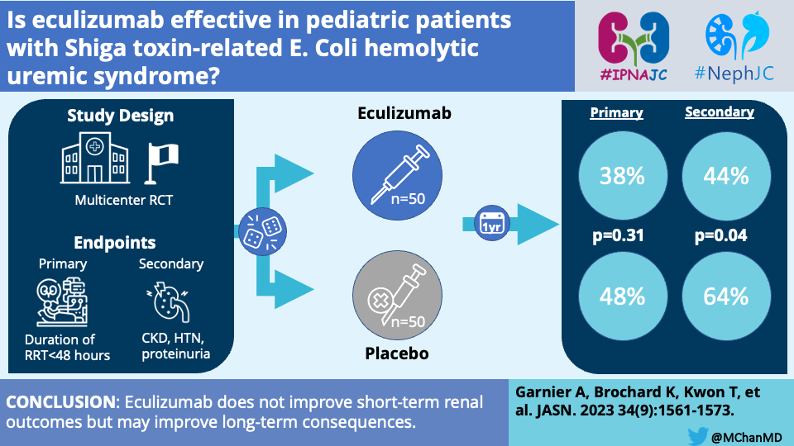

Slide 19
Thrombocytopenia
MAHA
±
Organ dysfunction
Primary TMA Syndromes
Systemic Diseases associated with low Plt & MAHA
TTP
STEC-HUS
aHUS
Drug induced TMA
Cancer induced TMA
Metabolism TMA
Coagulation TMA
Complications of pregnancy
Hypertension
Infections
Malignancy
Rheumatic diseases
HSCT/other organ Tx

Slide 20
Aberrant Complement
Activation
↓
Membrane Attack Complex
Ultra Large-vWF
ADAMTS13 Deficiency
TTP
CFH & CFI
CFB & C3
STEC HUS
aHUS

Slide 21
Thrombotic Microangiopathy: Atypical HUS
Complement Disease
Mostly gene mutations
CFH 20-30%
CD46 (Membrane cofactor protein) 5-15%
CFI 4-10%
C3 2-10%
THBD 3-5%
6-10% patients may have antibodies to complement proteins esp CFH
30+% pts may not have an identifiable mutation
<5% pts may have combined mutations
Majority of mutations show incomplete penetrance
KI (2015), 87, 882
JASN (2013), 24, 475

Slide 22

TREATMENT

Slide 23
Thrombocytopenia
MAHA
±
Organ dysfunction
Primary TMA Syndromes
Systemic Diseases associated with low Plt & MAHA
ADAMTS13
TTP
STEC-HUS
aHUS
Drug induced TMA
Metabolism TMA
Coagulation TMA
Complications of pregnancy
Hypertension
Infections
Malignancy
Rheumatic diseases
HSCT/other organ Tx

Slide 24
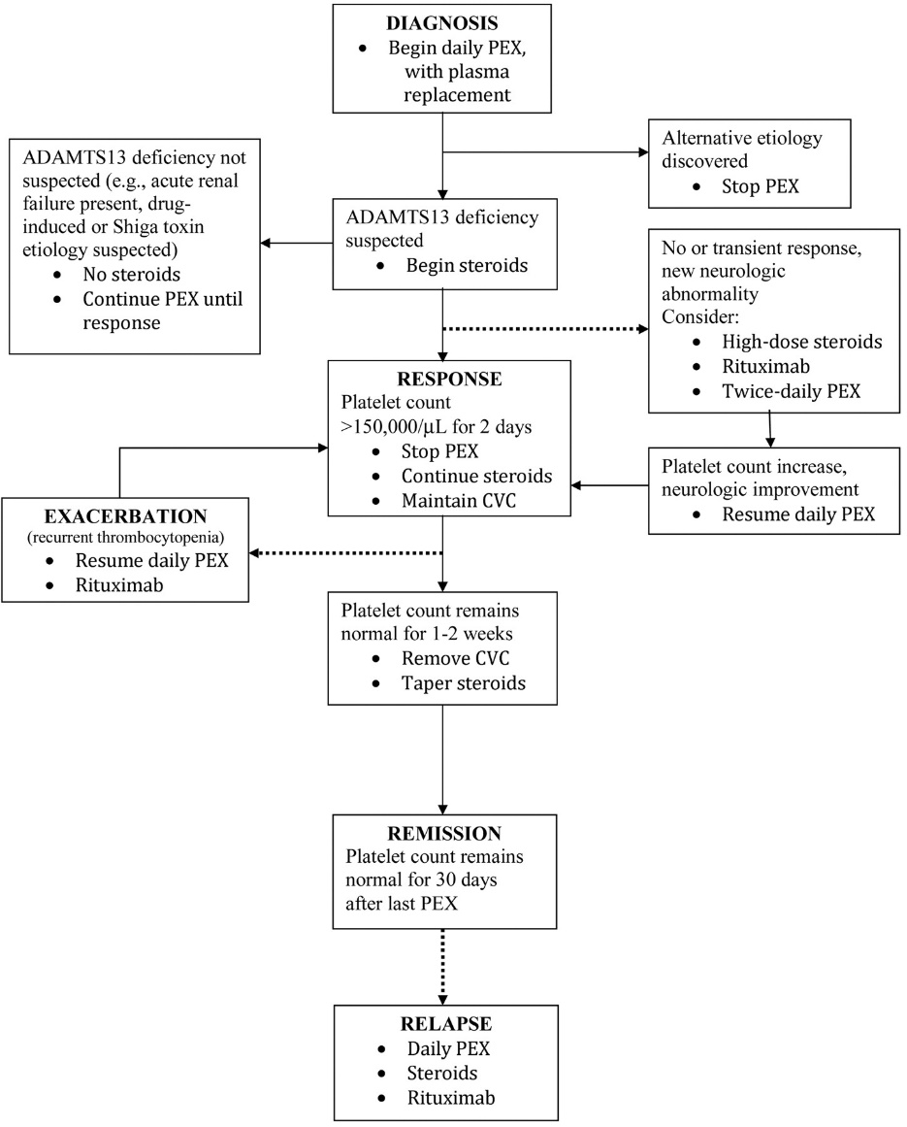
Thrombocytopenia
MAHA
±
Organ dysfunction
Primary TMA Syndromes
TTP
STEC-HUS
aHUS
Drug induced TMA
Metabolism TMA
Coagulation TMA
Blood 2010;116:4060-4069

Slide 25
Thrombocytopenia
MAHA
±
Organ dysfunction
Primary TMA Syndromes
Systemic Diseases associated with low Plt & MAHA
TTP
STEC-HUS
aHUS
Drug induced TMA
Metabolism TMA
Coagulation TMA
Complications of pregnancy
Hypertension
Infections
Malignancy
Rheumatic diseases
HSCT/other organ Tx

Slide 26
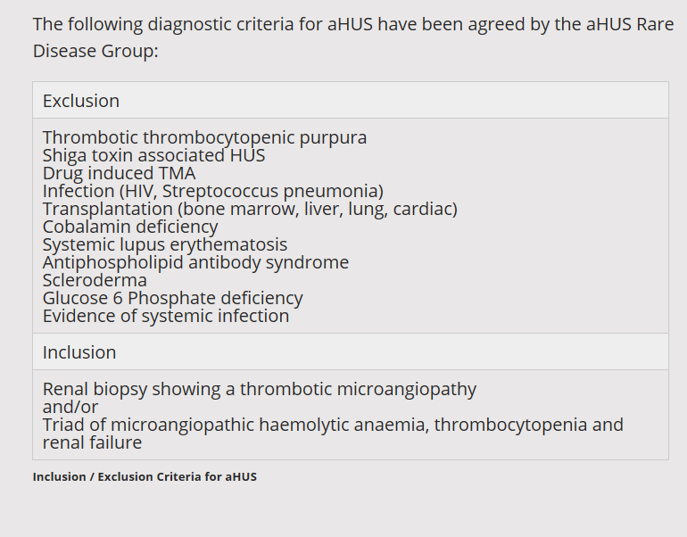
Thrombotic Microangiopathy: Atypical HUS
http://www.atypicalhus.co.uk/ahus/diagnosis/

Slide 27
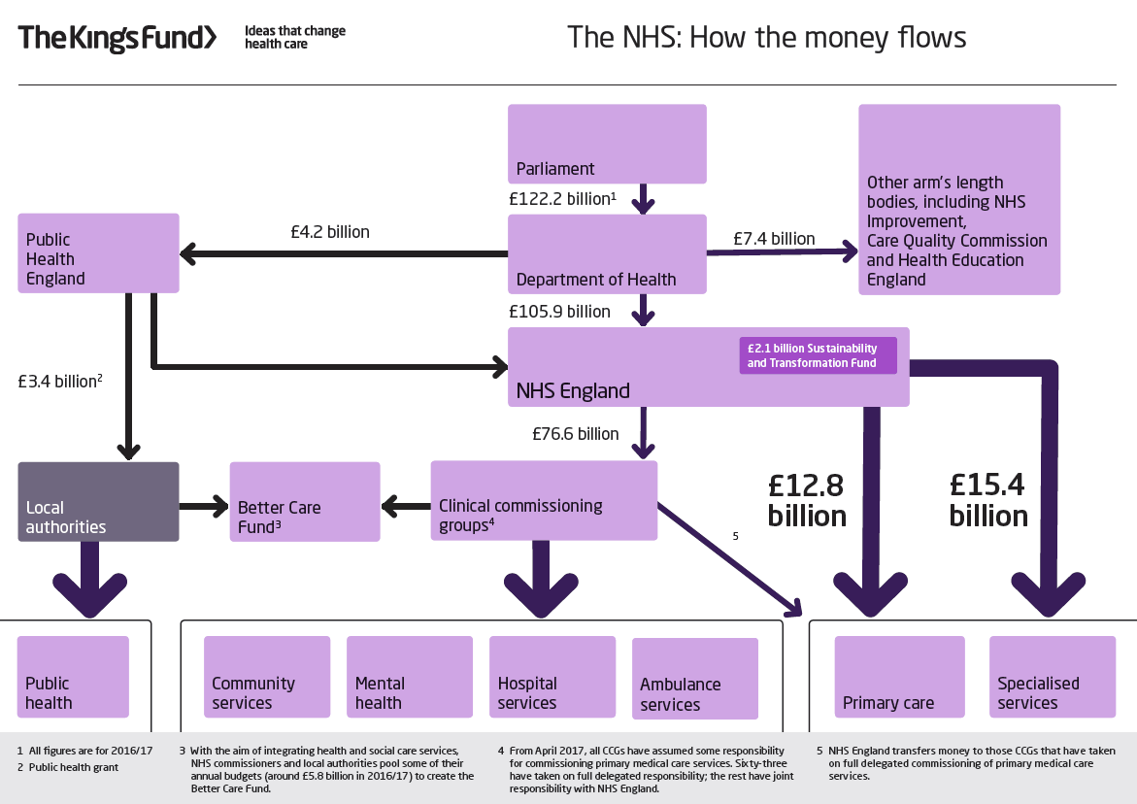
Thrombotic Microangiopathy: Treatment
ECULIZUMAB

Slide 28
Thrombotic Microangiopathy: aHUS treatment
http://www.atypicalhus.co.uk/emergency-referrals/
0191 2336161
2 Paper forms
Diagnostic checklist (short history and test results)
Shared care protocol
Phone call
YOU MUST HAVE AN ADAMTS13 RESULT
In North Thames this can be done quickest at UCL
https://www.ucl.ac.uk/haemostasis/adamts13-assays
If you want it extremely quickly it can be back same day if it gets there before 11am & you have a PO no

Slide 29
Thrombotic Microangiopathy: aHUS treatment
Genetic testing is performed centrally in Newcastle
STEC culture should be performed at your hospital
Your team needs to ensure molecular and serological STEC tests are sent to Colindale
When the drug has been approved, ALL PATIENTS should:
Receive Tetravalent (ACWY) and Bexsero vaccines against Meningococcus
Antibody titers should be sent 4-6/52 post-vaccination
Have an oral swab sent to exclude carriage of resistant Meningococcus
Receive prophylactic Abx
Cipro 500mg BD 2/52
Longterm Pen V or erythro

Slide 30
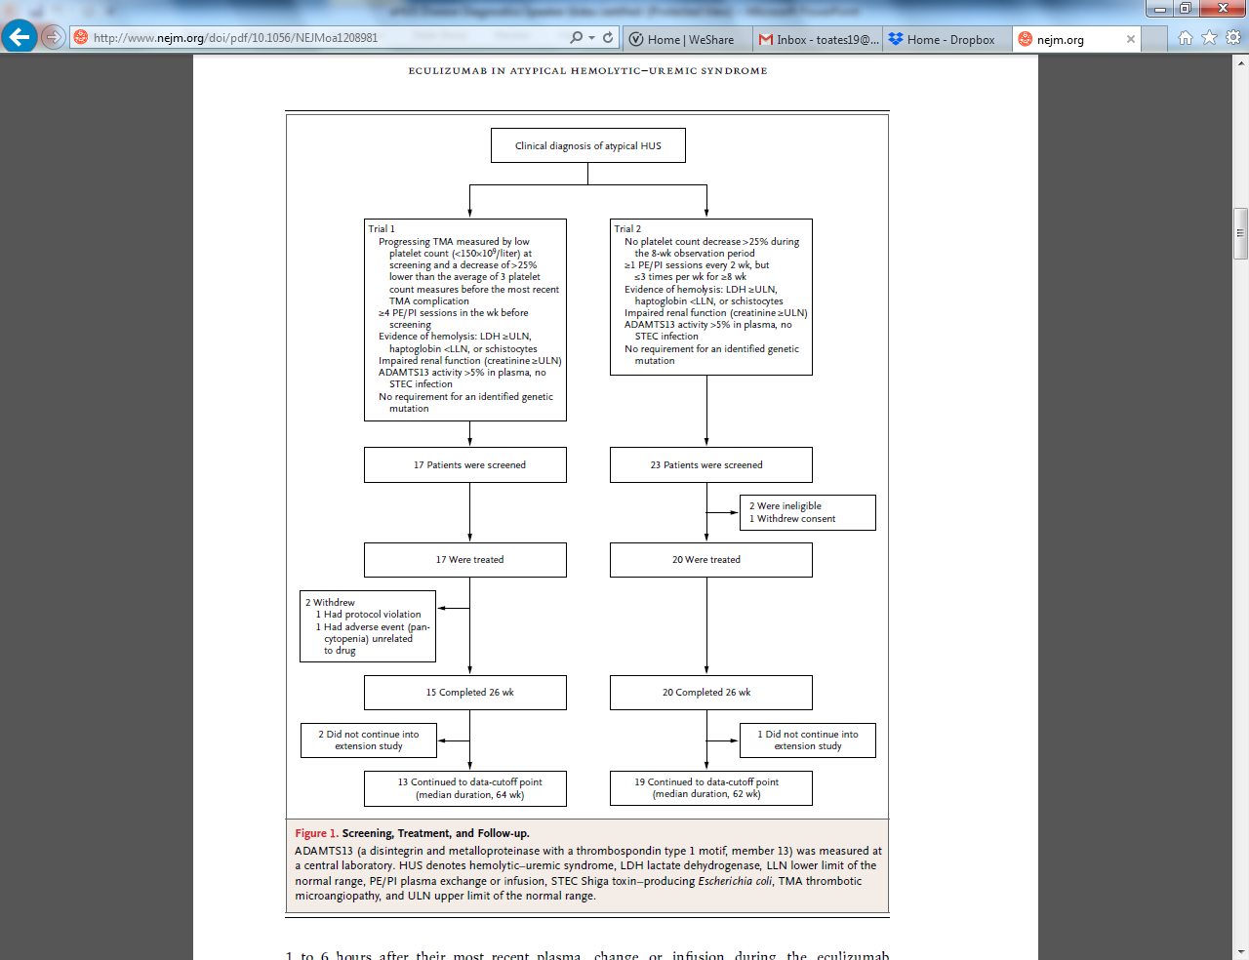
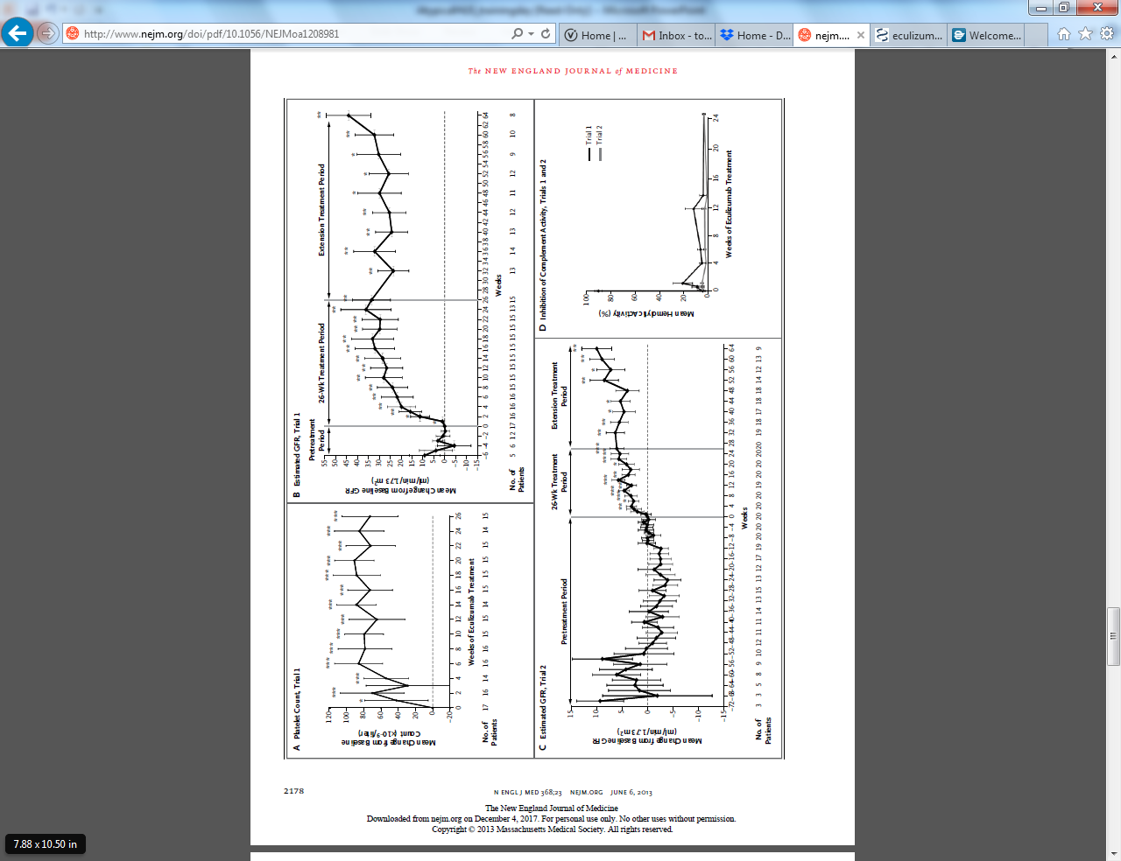
Thrombotic Microangiopathy: aHUS treatment
NEJM (2013), 368, 2169-2181

Slide 31
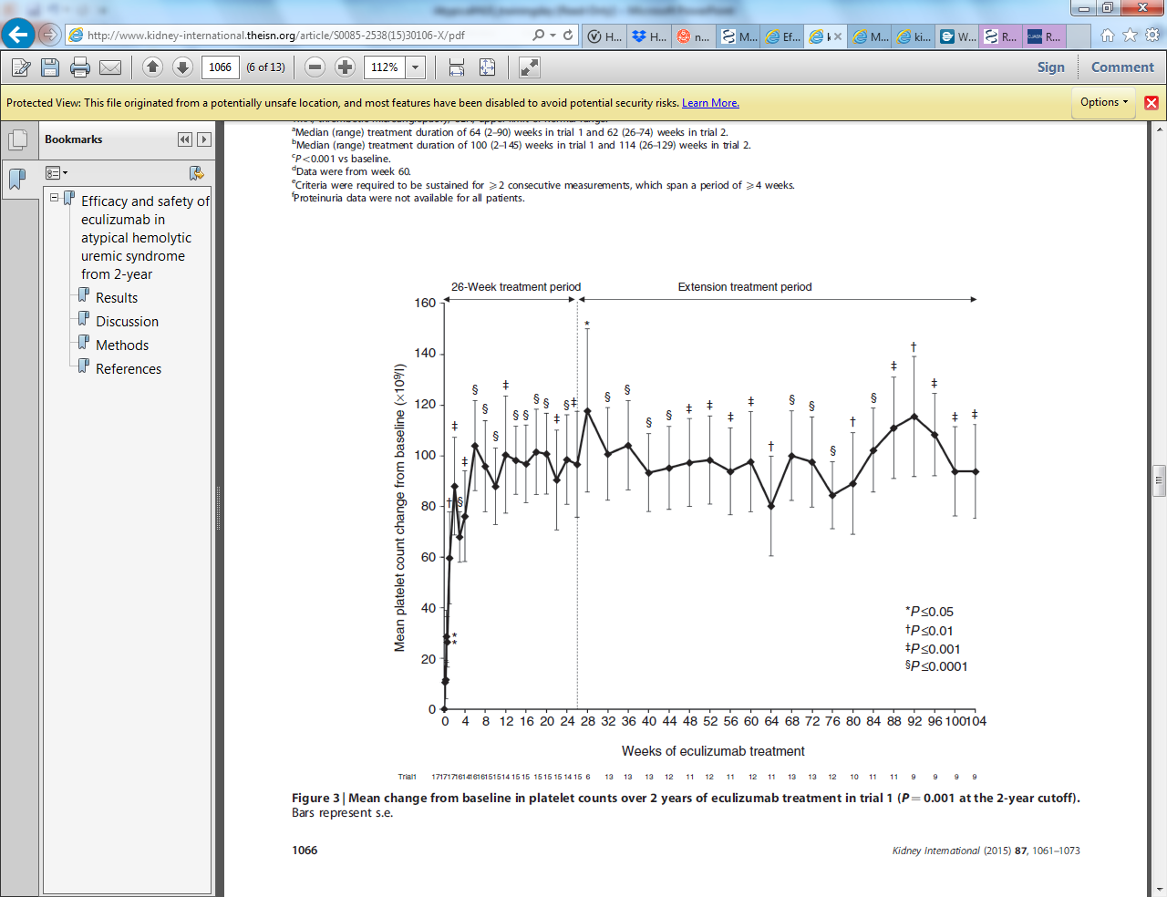
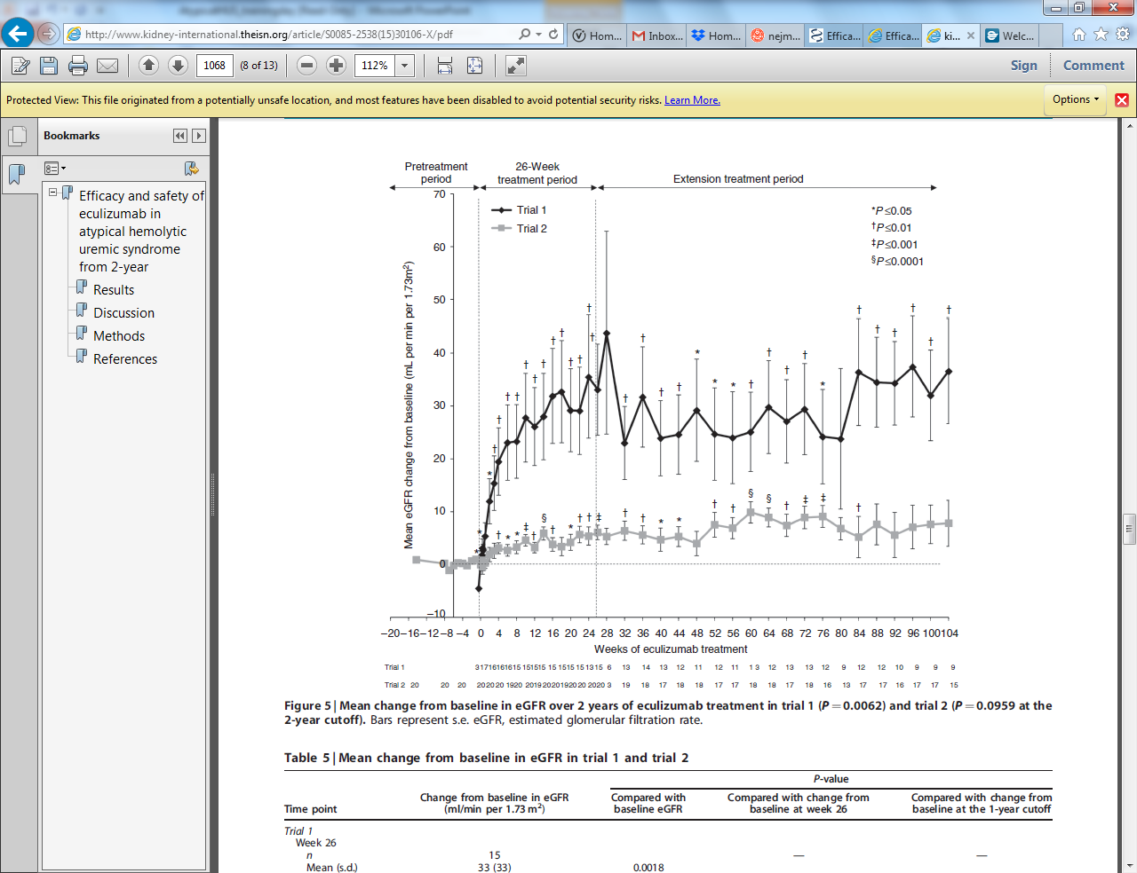
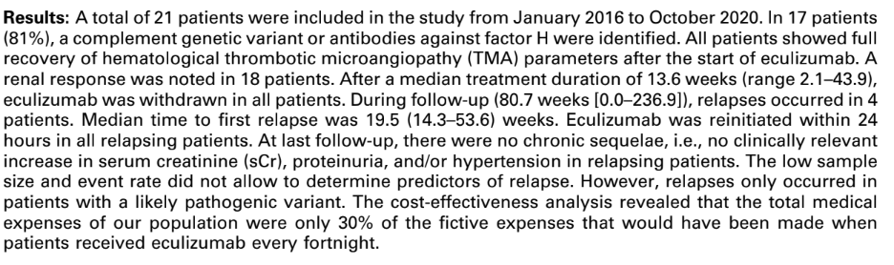
Thrombotic Microangiopathy: aHUS treatment
KI (2015) 87, 1061-1073
KI (2023) 8, 91-102

Slide 32
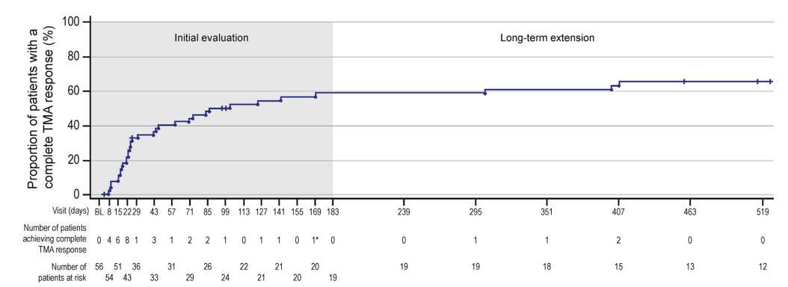
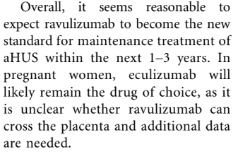
Thrombotic Microangiopathy: aHUS treatment
KI Rep (2021) 6, 1603-1613
KI (2020) 97, 1106-1108

Slide 33
Thrombotic Microangiopathy: Summary
The differential for TMA is wide but can be helped by doing relevant tests quickly
TTP will kill patients rapidly
Approval for Eculizumab is easy when you know how

